Slide 1
IMDB MOVIE ANALYSIS PROJECT - 5

Slide 2
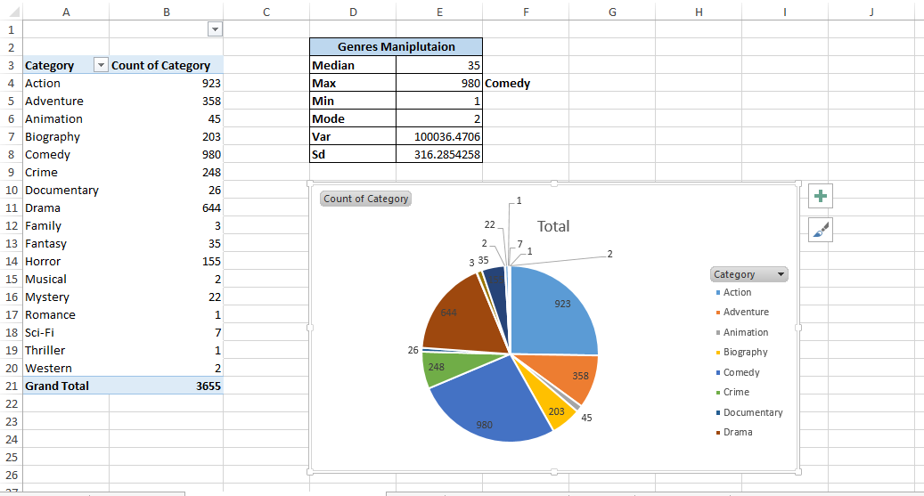
Movie Genre Analysis

Slide 3
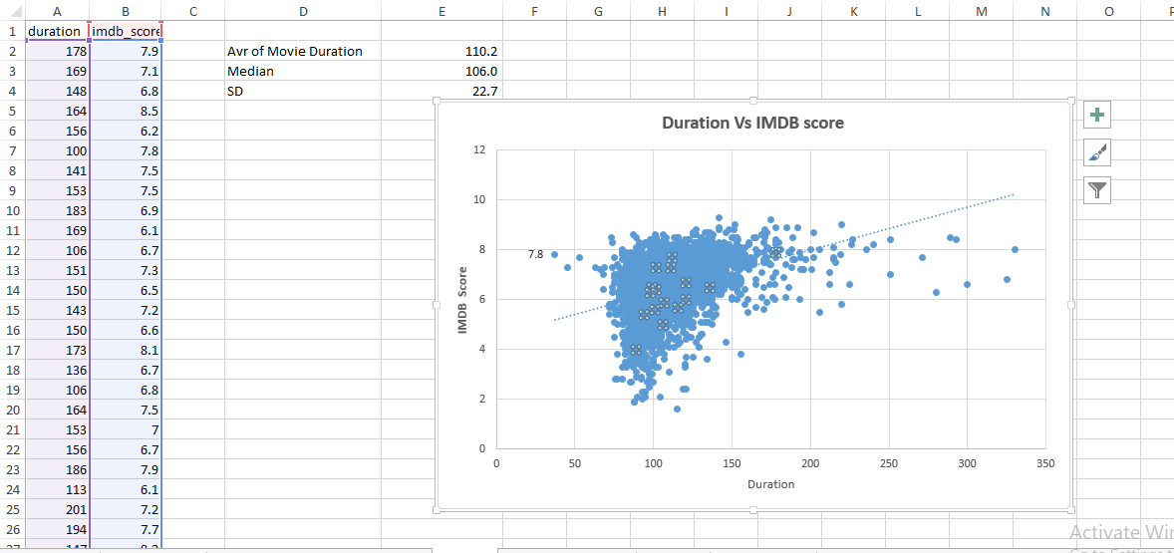
Movie Duration Analysis

Slide 4
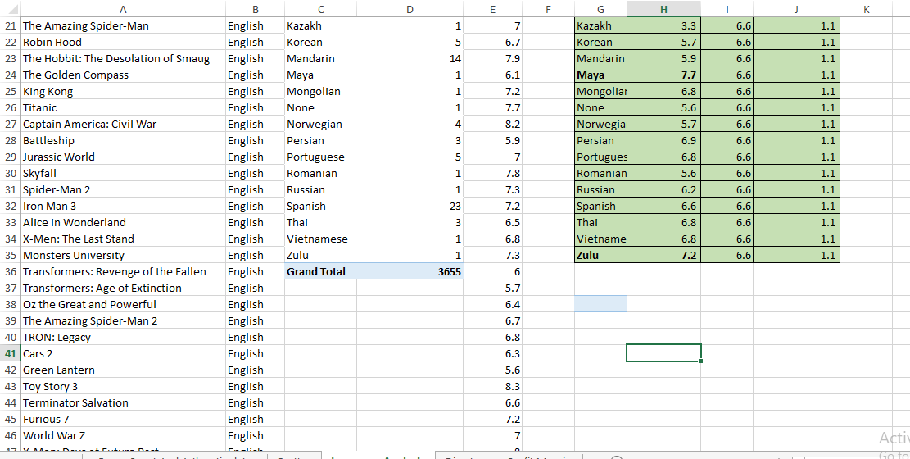
Language Analysis

Slide 5
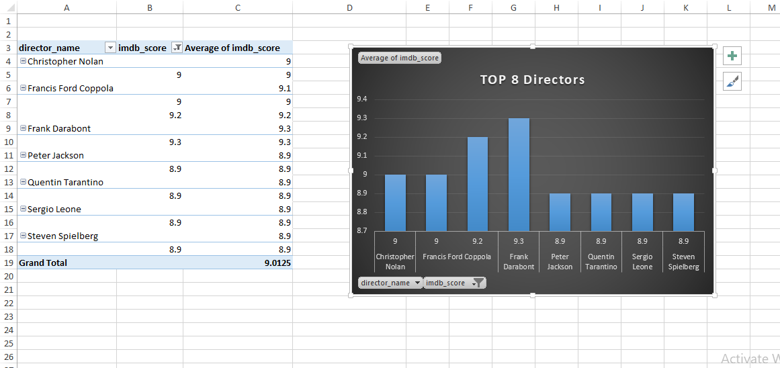
Director Analysis

Slide 6
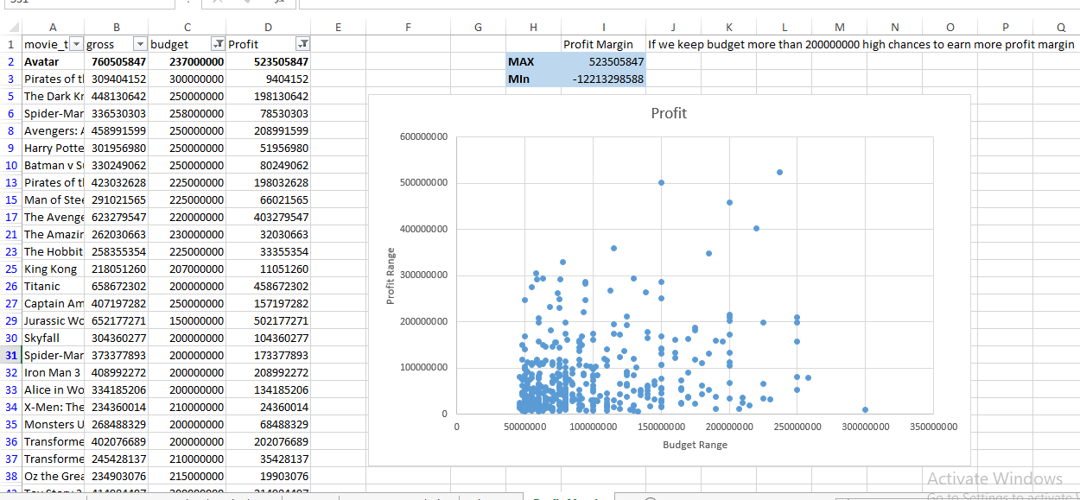
Budget Analysis

